Slide 1
NSC 329: Inventors Program
Sprint Problem
Anjali Sridharan (CHE)
Yuntong Qu (CS)
Vee Lee Koh (PGE)

Slide 2
WORKFLOW
Data Processing
Feature Selection
Time Series Forecasting Models
Vector Autoregression (VAR)
Autoregressive Integrated Moving Average (ARIMA)
Seasonal Autoregressive Integrated Moving-Average with Exogenous Regressors (SARIMAX)

Slide 3
DATA PROCESSING
Removed state production data
Determined to be redundant given U.S. Total Field Production
Resampled data at monthly rate to ensure consistency
Production data reported monthly
WTI oil price reported daily
Other parameters reported weekly (imports, exports, consumption)
Combined all data into one large dataframe

Slide 4
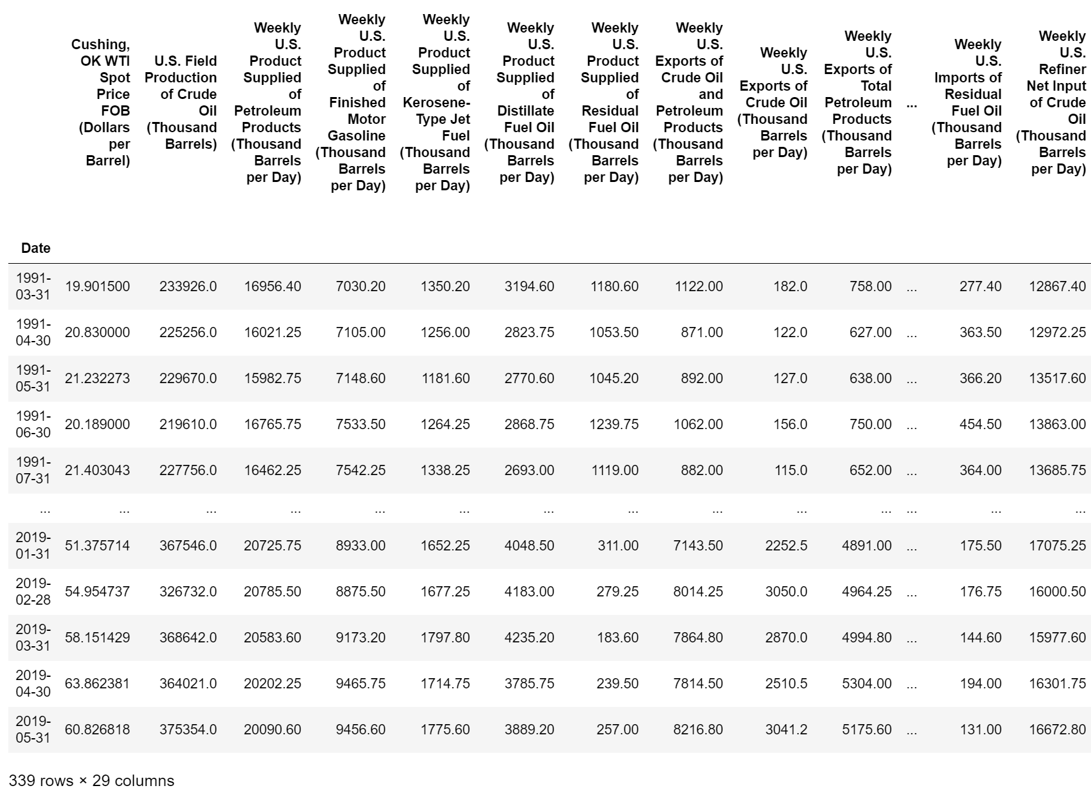
Notes:
Export data began 1991 Feb

Slide 5
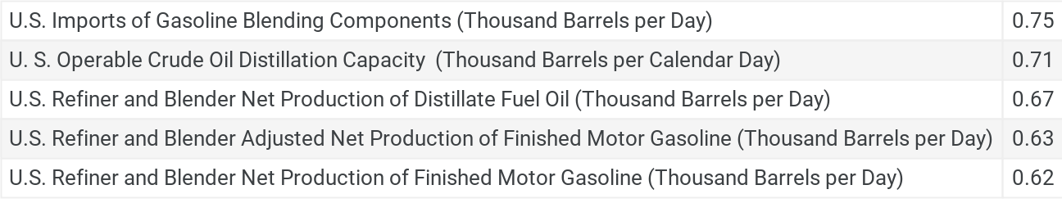
FEATURE SELECTION:
Correlation Matrix with Heatmap
Parameters to feed into model determined using highest correlation coefficient (linear regression)
Correlation Coefficient
Parameter

Slide 6
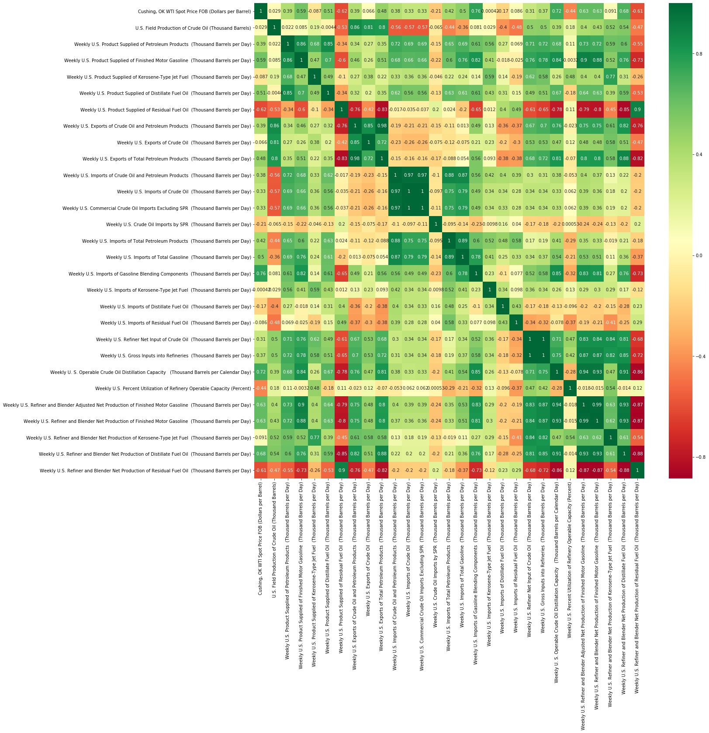
Correlation Matrix with Heatmap
U.S Imports of Gasoline Blending
U.S Crude Oil Distillation Capacity
U.S. Refiner and Blender Adjusted Net Production of Finished Motor Gasoline
U.S. Refiner and Blender Net Production of Finished Motor Gasoline
U.S Refiner and Blender Net Production of Distillate Fuel Oil

Slide 7
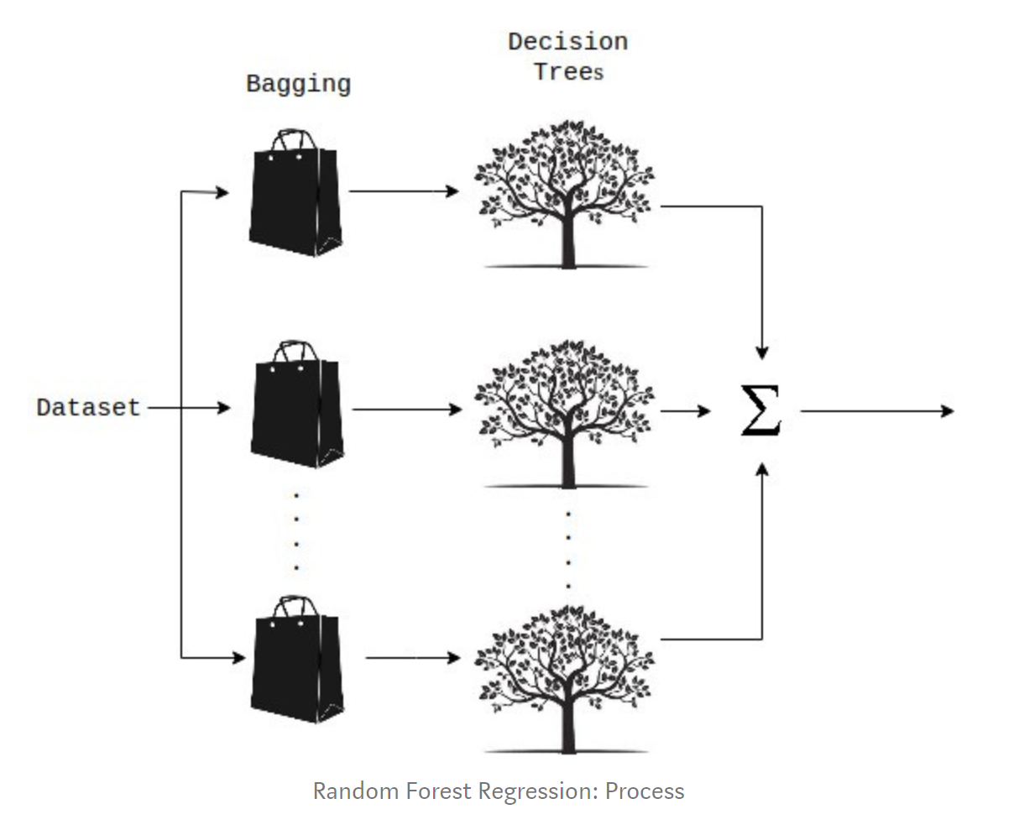
FEATURE SELECTION:
Feature Ranking using Random Forest Regression
Random Forest is an ensemble technique using regression, multiple decision trees and bagging
Notes:
Bagging - random sampling with replacement > training each decision tree on a different data sample where sampling is done with replacement.
The basic idea behind this is to combine multiple decision trees in determining the final output rather than relying on individual decision trees.

Slide 8
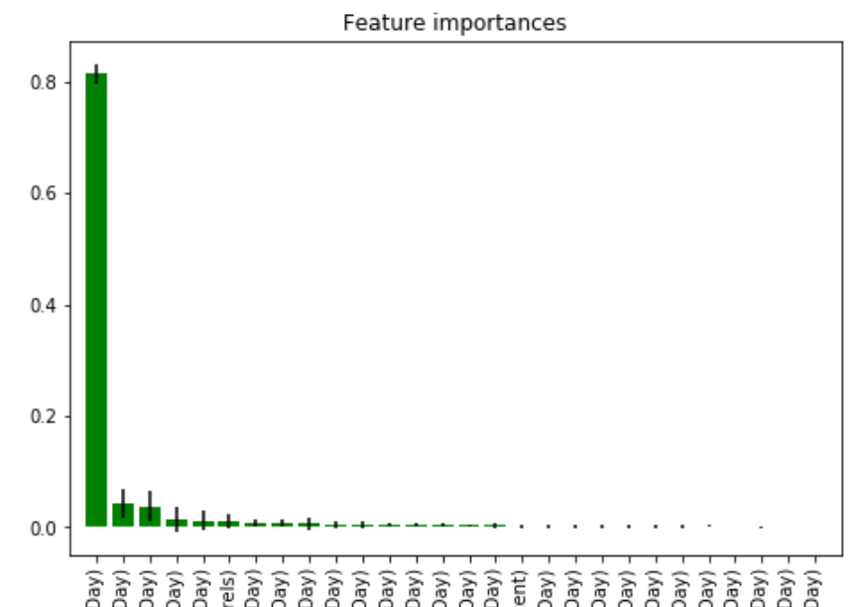
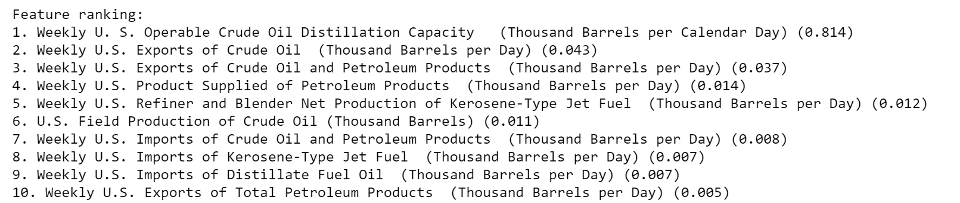

Slide 9
TIME SERIES FORECASTING MODELS
Vector Autoregression (VAR)
Models next step in time series using linear function of prior time steps
Based on the feature selections we ran, the two parameters with the highest correlations are:
US Imports of Gasoline Blending Components
US Operable Crude Oil Distillation Capacity
Caveat: Used for multivariate time series without trend and seasonal components

Slide 10
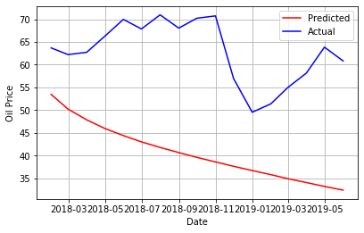
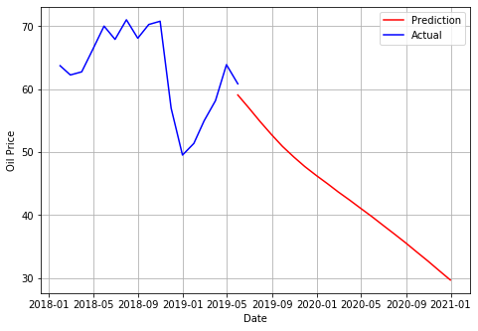
VAR Results
Validation
Prediction

Slide 11
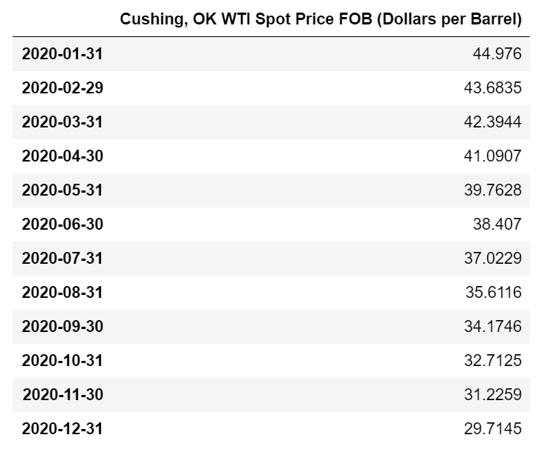
VAR Results
Prediction
Average Oil Price in 2020
$37.56

Slide 12
TIME SERIES FORECASTING MODELS
AutoRegressive Integral Moving Average (ARIMA)
Models next step in time series as linear function of the differenced observations and residual errors of prior time steps
Appropriate for univariate time series without trend and seasonal components
Notes:
From a theoretical perspective, VAR does not include moving-average (MA) terms and approximates any existing MA patterns by extra autoregressives lags, which is a less parsimonious solution than directly including MA terms as in an ARIMAX model

Slide 13
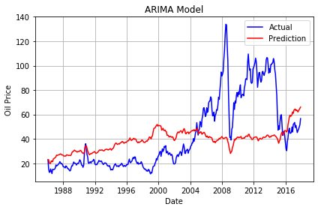
ARIMA Results
Validation
Result:
Unable to predict prices because of difficulty in considering trend and seasonality of future prices

Slide 14
TIME SERIES FORECASTING MODELS
Seasonal Autoregressive Integrated Moving-Average with Exogenous Regressors (SARIMAX)
Models the next step in time series using linear function of differenced observations, errors, differenced seasonal observations and seasonal errors of prior time steps
Appropriate for univariate time series with trend and/or seasonal components and exogenous variables

Slide 15
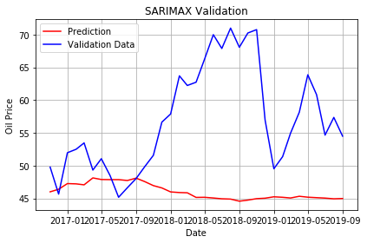
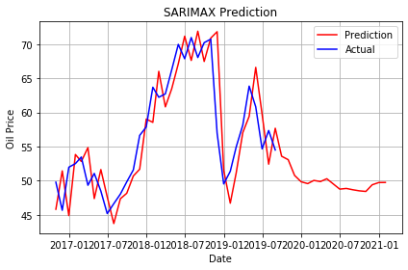
SARIMAX Results
Validation
Prediction

Slide 16
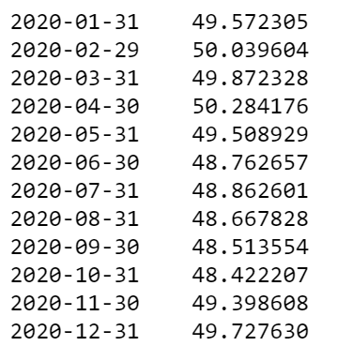
SARIMAX Results
Date Predicted Price
Average Oil Price in 2020
$49.30

Slide 17
CONCLUSION
2020 average oil price predicted to be between $37.56 and $49.30
Best model tested was SARIMAX, which could be further improved with order selection

Slide 18
STEPS FOR IMPROVEMENT
On SARIMAX model, we were not able to find the optimal “order” parameters (p,q,d) to use due to the huge computation required. We could introduce multiprocessing techniques.
We did not find a good method to evaluate model performance in terms of prediction accuracy.
Correlation coefficient (p-value) is not reliable for evaluating time series predictions
Use of other feature selection models like Spearman’s rank correlation coefficient and mutual information

Slide 19
THANK YOU !!!

